Slide 1
Satellite Motion and Kepler’s Third Law

Slide 2
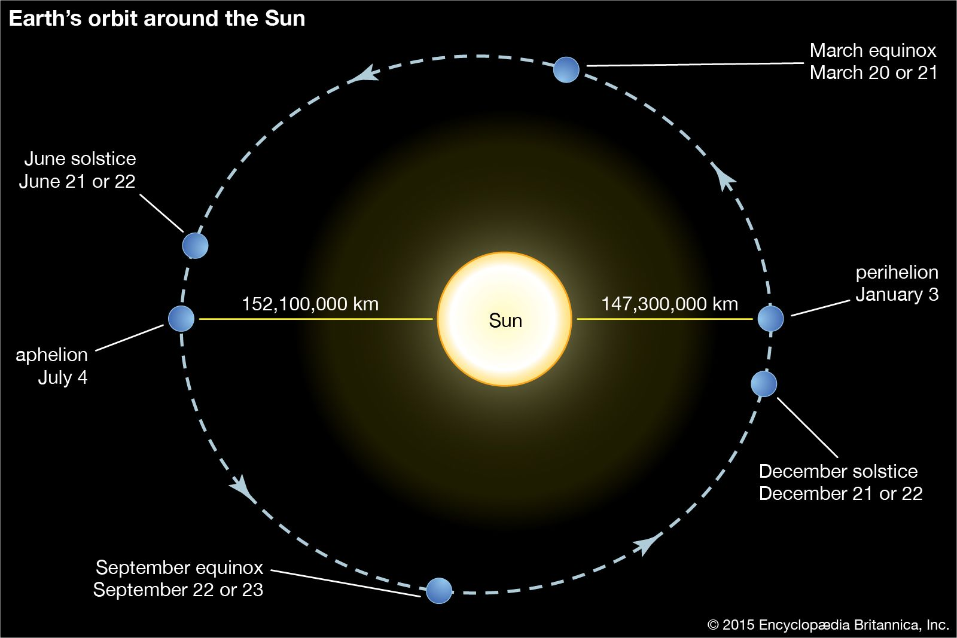
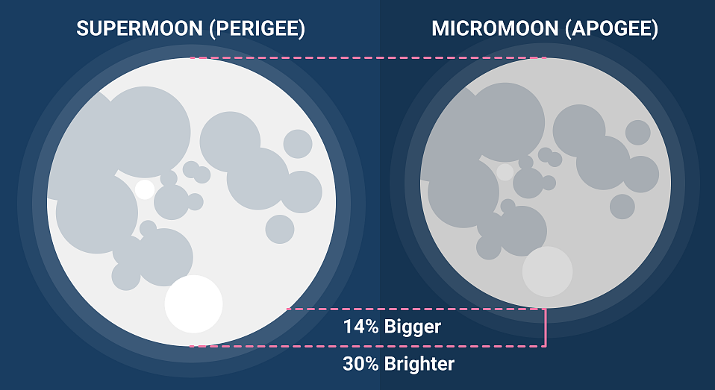
Satellites
Any object that orbits another can be called a satellite. This includes:
Natural satellites (e.g. a moon orbiting a planet, a planet orbiting a star)
Artificial satellites (used for communication, weather forecasting, navigation, surveillance, exploration, research, etc.)
Not all satellites travel in a perfectly circular path (in fact, most don’t!), but in this course you can assume that the orbits you’ll be working with are approximately circular.

Slide 3
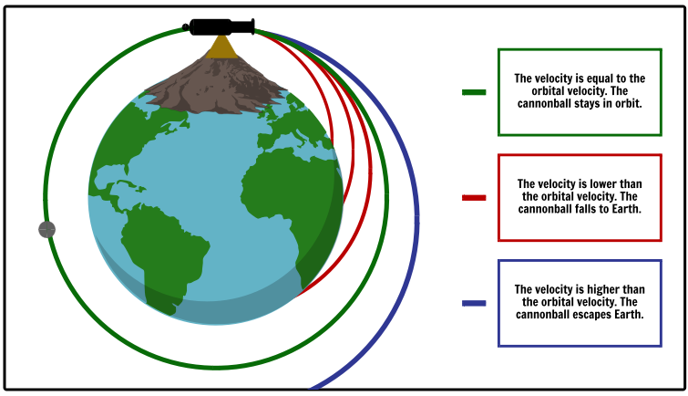
Newton’s Thought Experiment
Galileo believed that the mechanism that causes objects to fall and the one that causes satellites to orbit were different.
Newton proposed that both of these phenomena were caused by gravity, and devised a thought experiment to support his claim.
Imagine that you fire a cannonball from the top of a very tall mountain.
The faster the cannonball is moving, the further it will travel before it hits the ground.
Fire it too fast and it will fly off into space.
However, at a certain velocity, it should go all the way around the Earth and return to its original position.
If you get the cannon out of the way and ignore air resistance, the cannonball will orbit the Earth indefinitely.

Slide 4
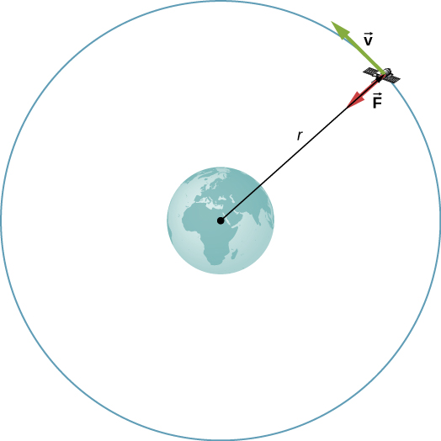
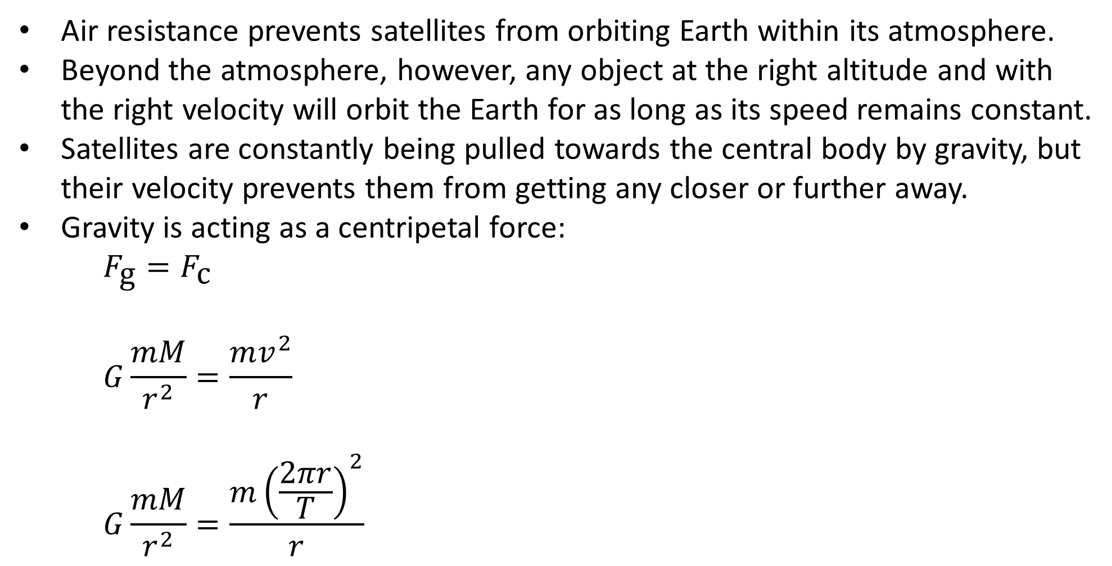
Satellite Motion
Air resistance prevents satellites from orbiting Earth within its atmosphere.
Beyond the atmosphere, however, any object at the right altitude and with the right velocity will orbit the Earth for as long as its speed remains constant.
Satellites are constantly being pulled towards the central body by gravity, but their velocity prevents them from getting any closer or further away.
Gravity is acting as a centripetal force:
$$F_{\text{g}}=F_{\text{c}}$$
$$G\frac{mM}{r^{2}}=\frac{mv^{2}}{r}$$
$$G\frac{mM}{r^{2}}=\frac{m{\left(\frac{2πr}{T}\right)}^{2}}{r}$$

Slide 5
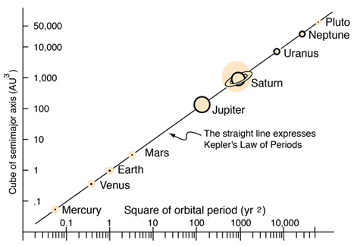

Satellite Motion
Gravity is acting as a centripetal force:
$$G\frac{mM}{r^{2}}=\frac{m{\left(\frac{2πr}{T}\right)}^{2}}{r}$$
$$\frac{GmM}{r^{2}}=\frac{4mπ^{2}r^{2}}{rT^{2}}$$
$$T^{2}=\frac{4mπ^{2}r^{4}}{GmMr}=\left(\frac{4π^{2}}{GM}\right)r^{3}$$
$$T^{2}=kr^{3}, \text{where} \text{k} \text{is} \text{a} \text{constant}$$
$$∴T^{2}∝r^{3}, \text{Kepler}\text{′}\text{s} \text{Third} \text{Law}$$
Notes:
Formula sheet gives T² / r³ = 4π² / GM
Note that the graph uses two logarithmic scales to space out the planets appropriately, and is working in AU (1 AU = distance between the Earth and the Sun) and years for convenience

Slide 6
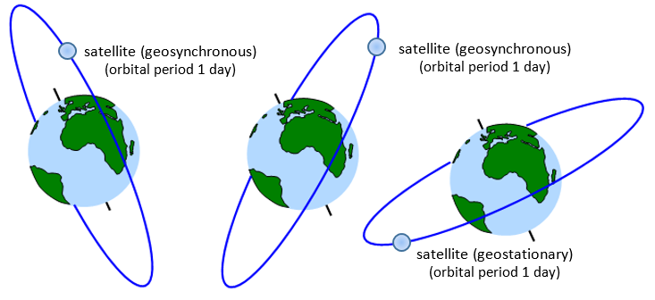
Satellite Types
Orbits can be classified according to their altitude:
Low Earth orbit (LEO), 160 – 1000 km: used for the ISS, satellite imaging, communications (in networks of satellites called constellations)
Geosynchronous orbit (GSO), 35,786 km: orbital period of exactly one day, i.e. orbits at the same speed the Earth rotates
Geosynchronous equatorial orbit (GEO), a.k.a. geostationary orbit – a GSO above the equator, resulting in a satellite that stays above a certain point on the Earth’s surface
Medium Earth orbit (MEO), between LEO and GSO: used for navigation
Notes:
There are orbits beyond GSO, but these are less commonly used (and, in many cases, significantly more complex).

Slide 7
Example
Calculate the orbital distance of a geosynchronous satellite orbiting the Earth. (Note that orbital distance refers to distance from a body’s centre of mass.)
Notes:
4.22 × 10⁷ m

